Slide 1


Slide 2
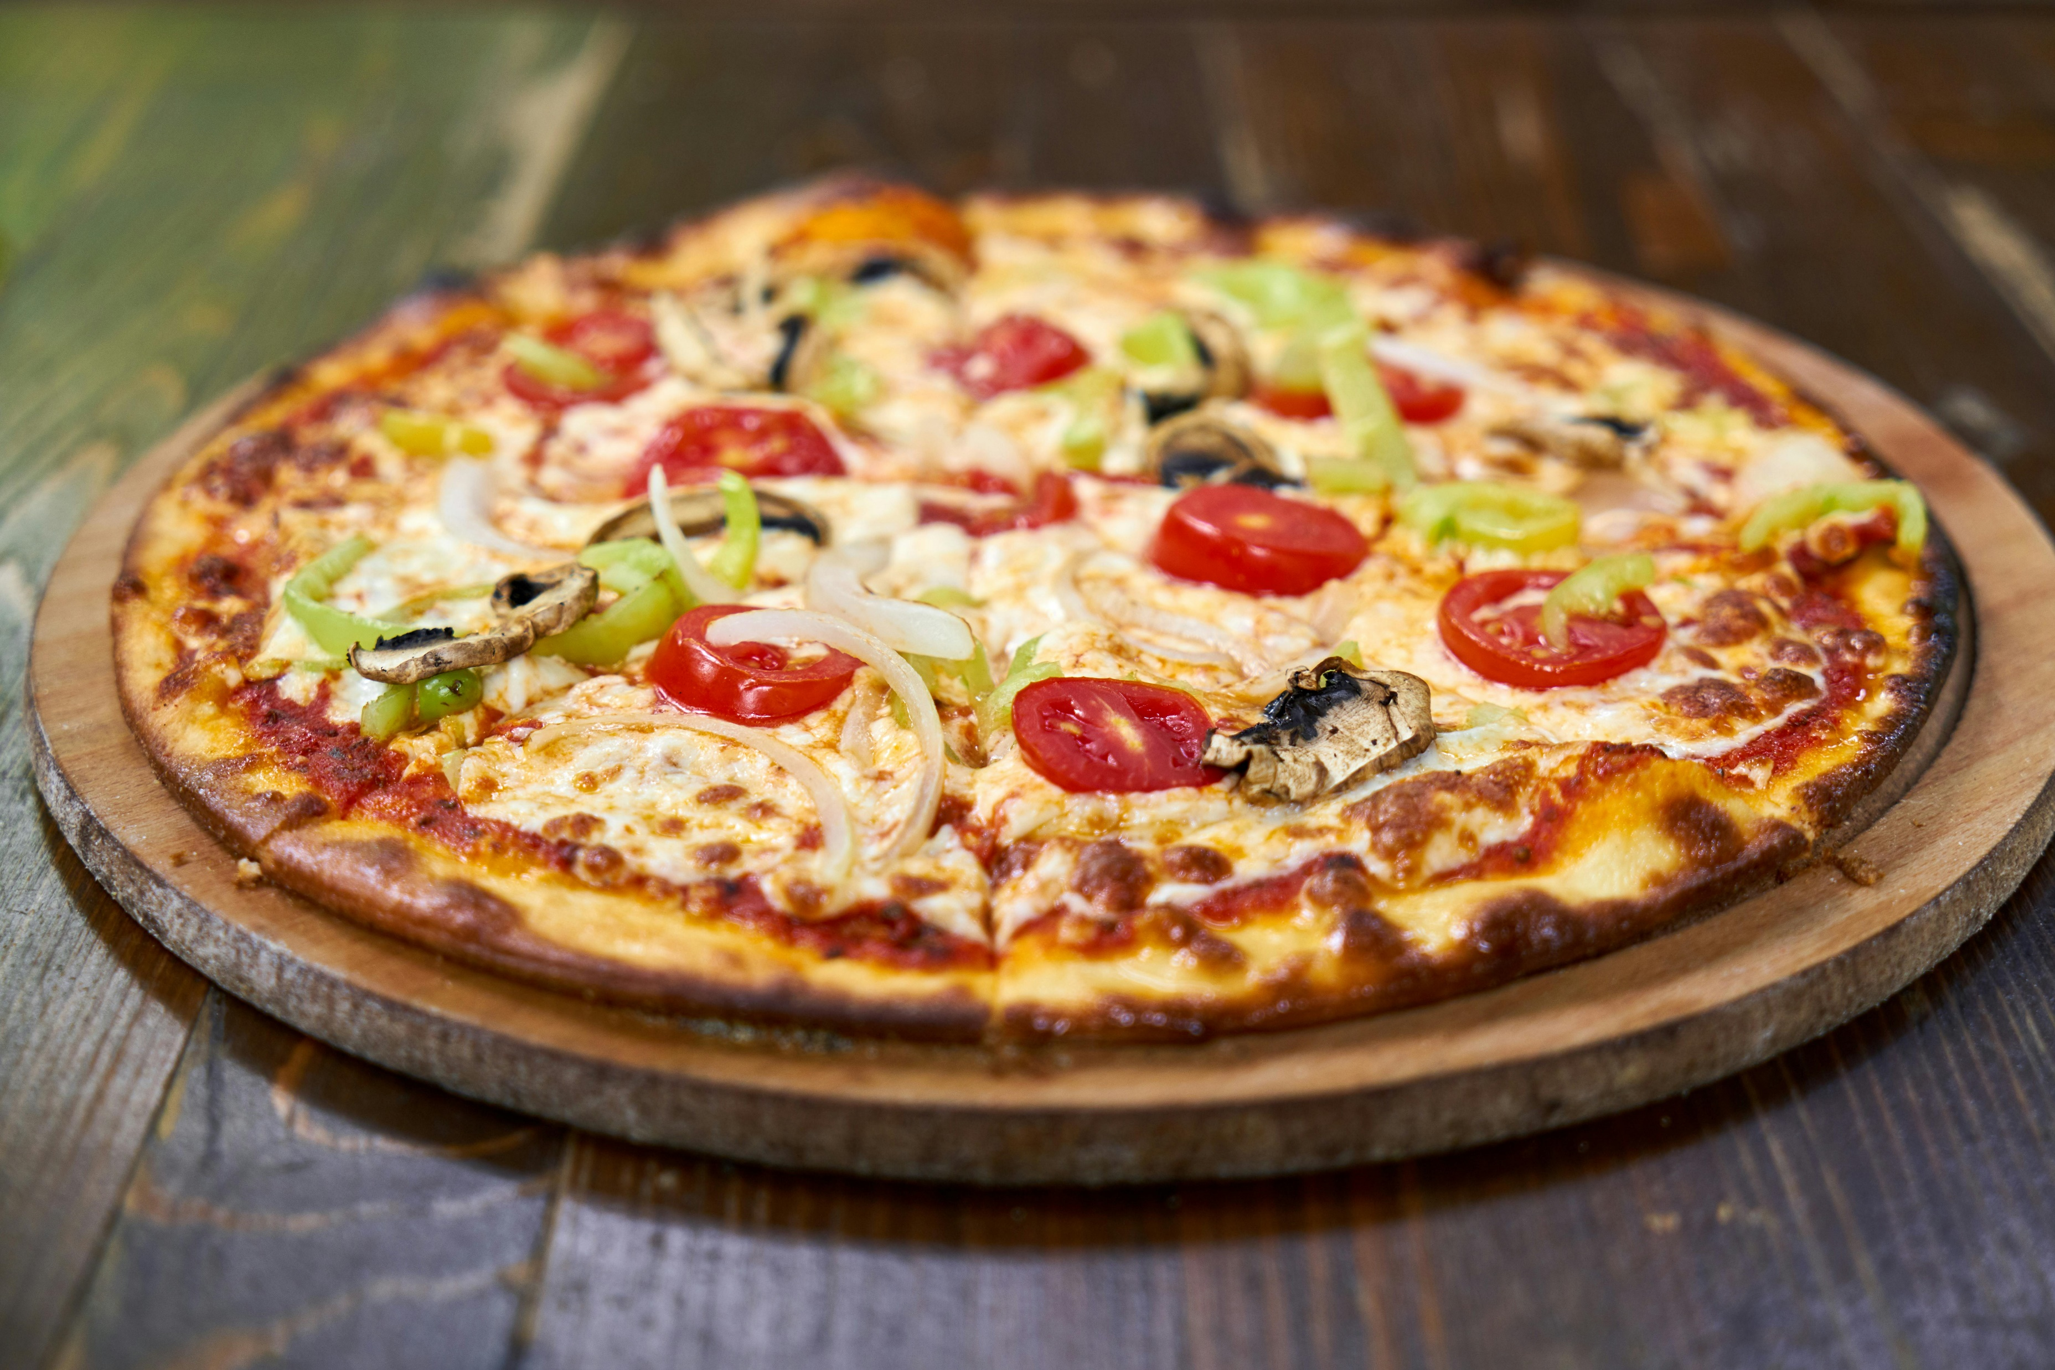
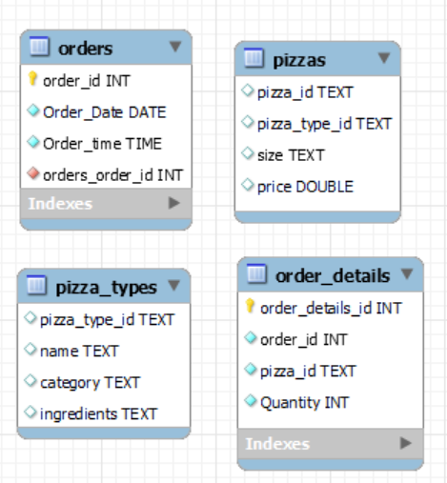
INTRODUCTION
Pizza Hut sales Database consist of four Tables

Slide 3
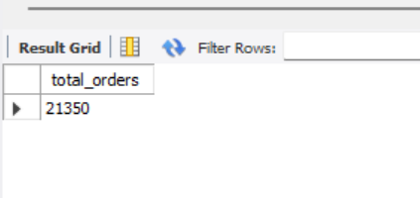
Task 1 Retrieve the total number of orders placed select count(order_id) as total_orders from orders ;

Slide 4
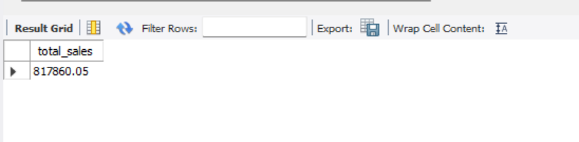
TASK 2 Calculate the total revenue generated SELECT ROUND(SUM(order_details.Quantity * pizzas.price), 2) AS total_sales FROM order_details JOIN pizzas ON pizzas.pizza_id = order_details.pizza_id;

Slide 5
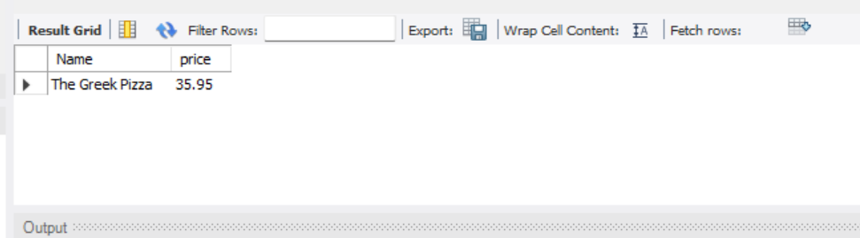
Task 3 Identify the highest priced pizza select pizza_types.Name, pizzas.price from pizza_types JOIN pizzas ON pizza_types.pizza_type_id = pizzas.pizza_type_id ORDER BY pizzas.price DESC LIMIT 1;

Slide 6
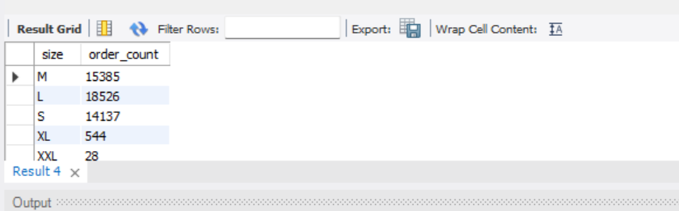
Task 4 Identify the most common pizza size ordered select pizzas.size, count(order_details.order_details_id) AS order_count from pizzas join order_details ON pizzas.pizza_id = order_details.pizza_id GROUP BY pizzas.size ;

Slide 7
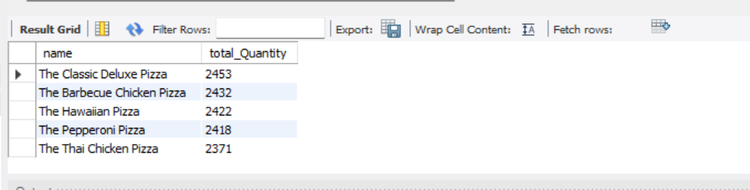
Task 5 List the top 5 most ordered pizza types along with their quantities Select pizza_types.name, sum(order_details.Quantity) AS total_Quantity from pizza_types JOIN pizzas ON pizza_types.pizza_type_id = pizzas.pizza_type_id JOIN order_details ON order_details.pizza_id = pizzas.pizza_id GROUP BY pizza_types.name ORDER BY total_Quantity DESC LIMIT 5;

Slide 8
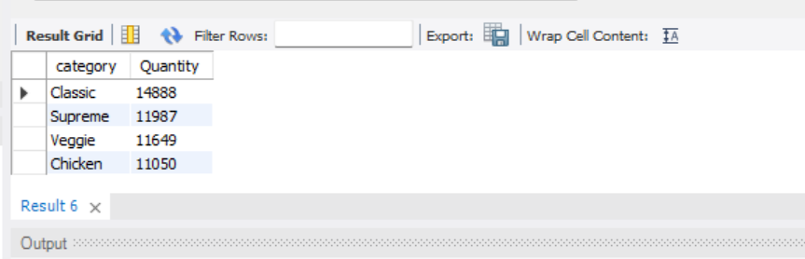
Task 6 join the necessary tables to find the total quantity of each pizza category Select pizza_types.category, SUM(order_details.Quantity) AS Quantity FROM pizza_types JOIN pizzas ON pizza_types.pizza_type_id = pizzas.pizza_type_id JOIN order_details ON order_details.pizza_id = pizzas.pizza_id GROUP BY pizza_types.category ORDER BY Quantity DESC;

Slide 9
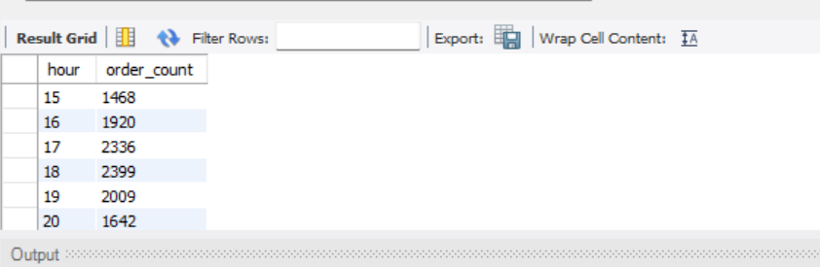
Task 7 Determine the distribution of orders by hour of the day select hour(order_time) as hour,count(order_id) as order_count from orders group by hour(order_time);

Slide 10
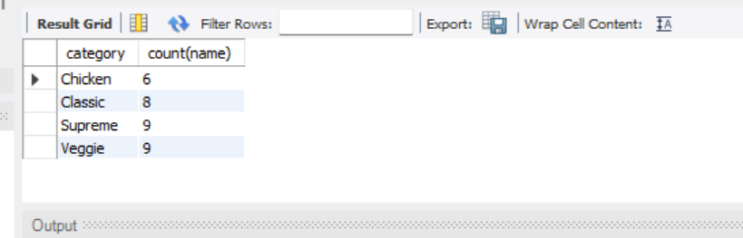
Task 8 Join relevant tables to find the category-wise distribution of pizzas select category, count(name) from pizza_types group by category ;

Slide 11
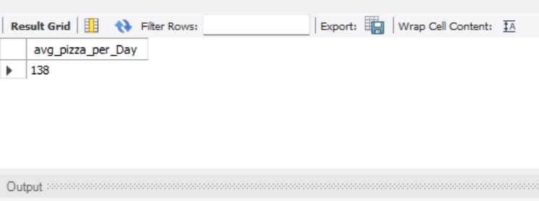
Task 9 Group the orders by date and Calculate the average number of pizzas ordered per day SELECT ROUND(AVG(quantity), 0) as avg_pizza_per_Day FROM (SELECT orders.Order_Date, SUM(order_details.Quantity) AS Quantity FROM orders JOIN order_details ON orders.order_id = order_details.order_id GROUP BY orders.order_Date) AS order_Quantity;

Slide 12
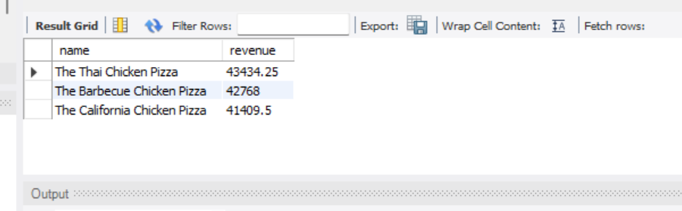
Task 10 Determine the Top 3 most ordered pizza types based on revenue Select pizza_types.name,SUM(order_details.Quantity * pizzas.price) AS revenue FROM pizza_types JOIN pizzas ON pizzas.pizza_type_id= pizza_types.pizza_type_id JOIN order_details ON order_details.pizza_id = pizzas.pizza_id GROUP BY pizza_types.name ORDER BY revenue DESC LIMIT 3;

Slide 13
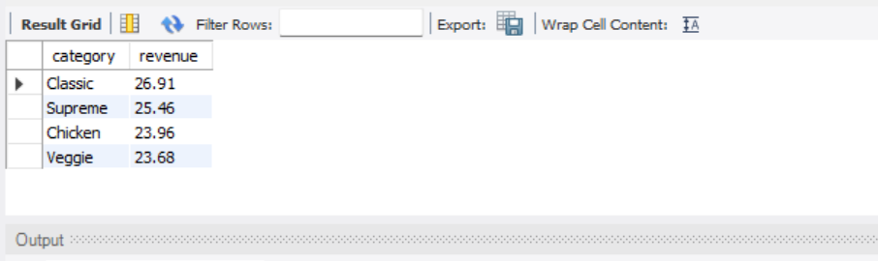
Task 11 Calculate the percentage contribution of each pizza type to total revenue SELECT pizza_types.category, ROUND(SUM(order_details.Quantity * pizzas.price) / (Select ROUND(SUM(order_details.Quantity * pizzas.price) 2) AS total_sales FROM order_details JOIN pizzas ON pizzas.pizza_id = order_details.pizza_id) * 100, 2) AS revenue FROM pizza_types JOIN pizzas ON pizza_types.pizza_type_id = pizzas.pizza_type_id JOIN order_details ON order_details.pizza_id = pizzas.pizza_id GROUP BY pizza_types.category ORDER BY revenue DESC;

Slide 14
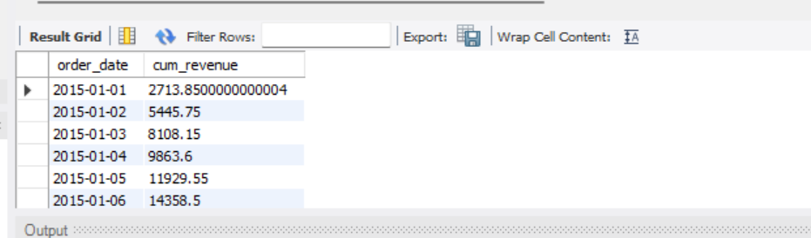
Task 12 Analyze the Cumulative revenue generated over time select order_date, sum(revenue) over(order by order_date) as cum_revenue from (select orders.Order_Date, sum(order_details.Quantity * pizzas.price) as revenue from order_details join pizzas on order_details.pizza_id = pizzas.pizza_id join orders on orders.order_id = order_details.order_id group by orders.order_Date) as sales ;

Slide 15
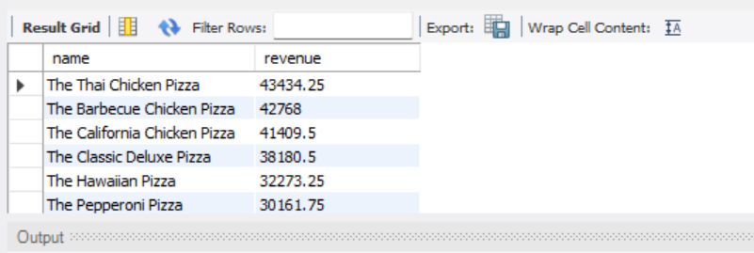
Task 13 Determine the top 3 most ordered pizza types Based on revenue for each category select name,revenue from (select category,name,revenue,Rank() over (partition by category order by Revenue desc) as rn from (select pizza_types.category,pizza_types.name,sum((pizzas.price) * order_details.Quantity) as Revenue from pizza_types join pizzas on pizza_types.pizza_type_id = pizzas.pizza_type_id join order_details on order_details.pizza_id = pizzas.pizza_id group by pizza_types.category,pizza_types.name) as a) as b where rn <= 3 ;

Slide 16
THANK YOU !

